Slide 1
Introduction to File Processing

Slide 2







Three-Schema Architecture
External
View #1
External
View #2
...
External
View #n
mapping
Conceptual Schema
mapping
Internal Schema
Stored database
Notes:
25
Internal level
It describes the physical storage structure of the DB and access paths. The internal schema uses a physical data model
Conceptual level
It describes the structure of the whole DB for a community of users.
Conceptual schema hides the details of physical storage structures.
External or View level
includes a number of external schemas or user views.
Each external schema describes the part of the DB that a particular user group is interested in and hides the rest of the DB from that user group.
A HL data model or implementation data model can be used at this level.
Notice that the 3 schemas are only description of data, the only data that actually exists is at the physical level.
Most DBMS support the 3 level arch. To some extent
3-schema arch. Can achieve true data independence
Mapping info are stored in the catalog

Slide 3
Objectives of Three-Level Architecture
All users should be able to access same data.
A change in a user’s view should not affect other users’ views.
Users should not need to know physical database storage details.

Slide 4
Objectives of Three-Level Architecture
DBA should be able to change database storage structures without affecting the users’ views.
Internal structure of database should be unaffected by changes to physical aspects of storage.
DBA should be able to change conceptual structure of database without affecting all users.

Slide 5
Three-Level Architecture
External Level
  Users’ view of the database.
  Describes that part of database that is relevant to a particular user.
  The way perceived by end users.
Conceptual Level
  Community view of the database.
  Describes what data is stored in database and relationships among the data.
  The way perceived by the DBA & programmers.

Slide 6
Three-Level Architecture
Internal Level
  Physical representation of the database on the computer.
  Describes how the data is stored in the database.
  The way perceived by the DBMS & OS.

Slide 7
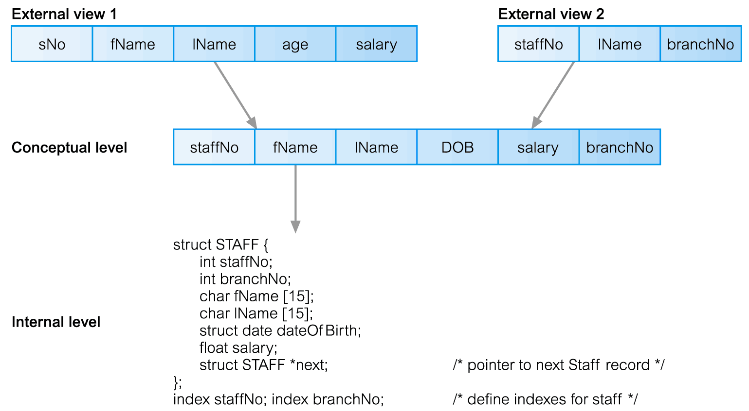
Differences between Three Levels

Slide 8
Schemas, Mappings
Mapping is the process of transforming requests and results between the Internal, Conceptual & External levels.
  Programs refer to an external schema, and are mapped by the DBMS to the internal schema for execution.
  Data extracted from the internal DBMS level is reformatted to match the user’s external view.
Two types of mapping:
– External / Conceptual mapping.
– Conceptual / Internal mapping.

Slide 9
Data Independence
Logical Data Independence
  Refers to immunity of external schemas to changes in conceptual schema.
  Conceptual schema changes (e.g. addition/removal of entities).
  Should not require changes to external schema or rewrites of application programs.

Slide 10
Data Independence
Physical Data Independence
  Refers to immunity of conceptual schema to changes in the internal schema.
  Internal schema changes (e.g. using different file organizations, storage structures/devices).
  Should not require change to conceptual or external schemas.

Slide 11
File Structures
Sequential File
Indexed Sequential File
Direct File
Hash File

Slide 12
File
A file is an external collection of related data treated as a unit.
Files are stored in auxiliary/secondary storage devices.
  Disk
  Tapes
A file is a collection of data records with each record consisting of one or more fields.

Slide 13
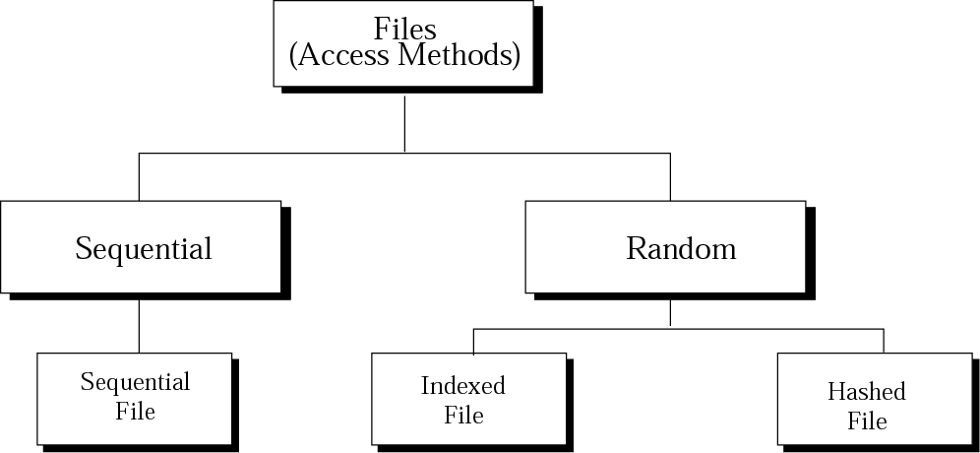
Taxonomy of file structures
The access method
determines how records can be retrieved: sequentially or randomly.
One record after another,
from beginning to end
Access one specific record
without having to retrieve all records before it

Slide 14
SEQUENTIAL
FILES

Slide 15
Sequential Files
Sequential file: A file whose contents can only be read in order
  Reader must be able to detect end-of-file (EOF)
  Data can be stored in logical records, sorted by a key field
    Greatly increases the speed of batch updates

Slide 16
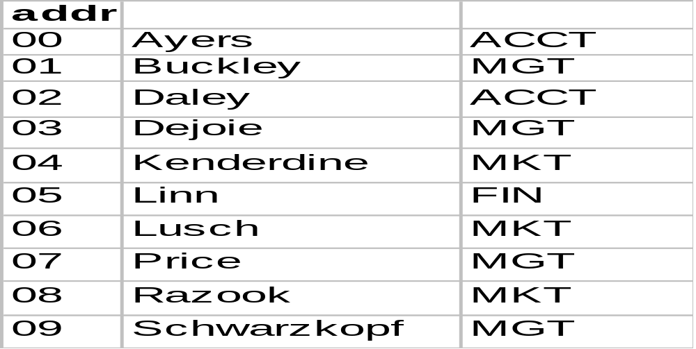
Sequential File
Sequential file sorted in alphabetical order. Sequential files are usually sorted in ID sequence order to facilitate batch processing.

Slide 17
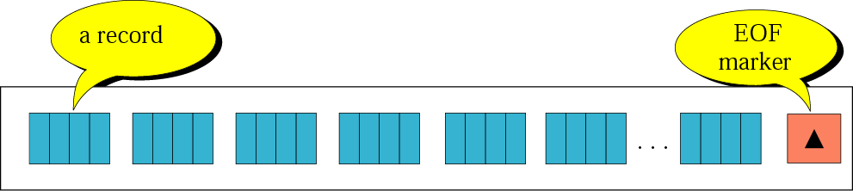
Sequential file
Sequential file –
records can only be accessed sequentially, one after another, from beginning to end.

Slide 18
Applications
Applications –
that need to access all records from beginning to end.
  Personal information
Because you have to process each record, sequential access is more efficient and easier than random access.
Sequential file is not efficient for random access.

Slide 19
Operation on Sequential File
Unsorted File\Sorted File
Add Record
Delete Record Logical/Physical Deletion
Update Record
Retrieve Record

Slide 20
Updating sequential files
sequential files must be updated periodically to reflect changes in information.
The updating process –
all of the records need to be checked and updated
(if necessary) sequentially.
  New Master File
  Old Master File
  Transaction File –
  contains changes to be applied to the master file.
    Add transaction
    Delete transaction
    Change transaction
    A key is one or more fields that uniquely identify the data in the file.

Slide 21
Sequential File Processing
Old Master
Process
New Master
Transaction
Sequential files must be recopied from the point of any insertion or deletion to the end of the file. They are commonly used in batch processing where a new master file will be generated each time the file is updated.

Slide 22
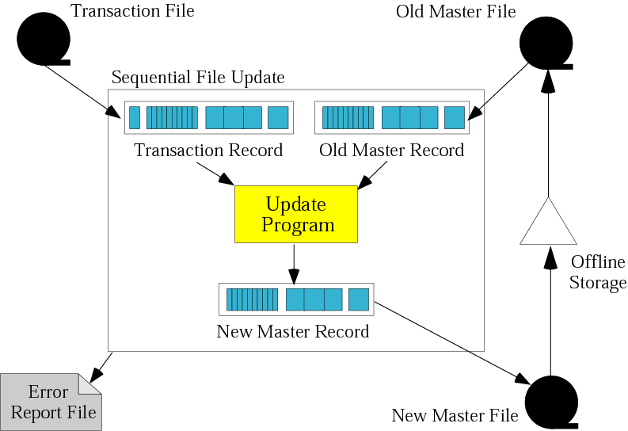
Updating a sequential file

Slide 23
Updating sequential files
To make updating process efficient, all files are sorted on the same key.
The update process requires that you compare :
[transaction file key] vs. [old master file key]
  < : add transaction to new master
  = :
    Change content of master file data (transaction code = R(revise) )
    Remove data from master file (transaction code = D(delete) )
  > : write old master file record to new master file
  (transaction code = A(add) )

Slide 24
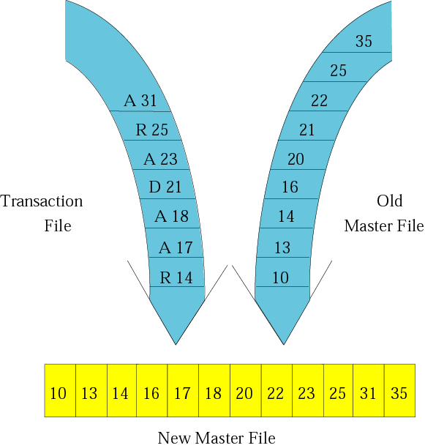
Updating process

Slide 25
INDEXED
FILES

Slide 26
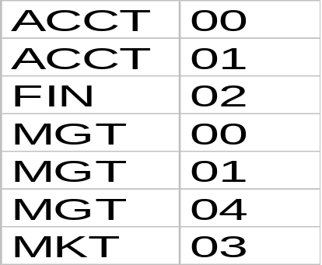
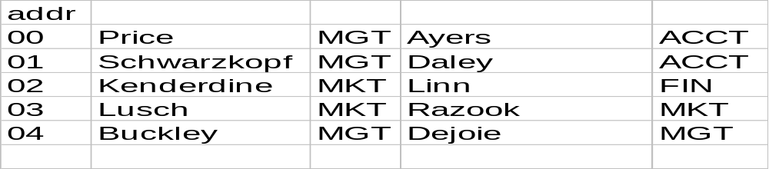
Indexed File
(sequential index)
Index to access data by department abbreviation.

Slide 27
Indexed File Processing
Index
Index
Data File
When a record is inserted or deleted in a file the data can be added at any location in the data file. Each index must also be updated to reflect the change. For a simple sequential index this may mean rewriting the index for each insertion.

Slide 28
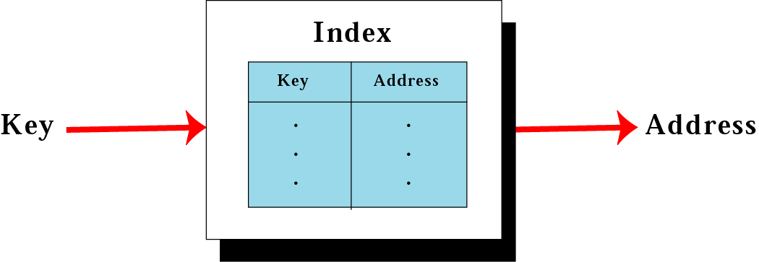
Mapping in an indexed file
To access a record in a file randomly,
you need to know the address of the record.
An index file can relate the key to the record address.

Slide 29
Indexed File
key pointer
Data item for Brown
Brown | P1
Johnson | P2
Jones | P3
Smith | P4
Watson | P5
Data file
Index file
Index: A list of key values and the location of their associated records

Slide 30
Indexed files
An index file is made of a data file, which is a sequential file, and an index.
Index – a small file with only two fields:
  The key of the sequential file
  The address of the corresponding record on the disk.
To access a record in the file :
  Load the entire index file into main memory.
  Search the index file to find the desired key.
  Retrieve the address the record.
  Retrieve the data record. (using the address)
Inverted file –
you can have more than one index, each with a different key.

Slide 31
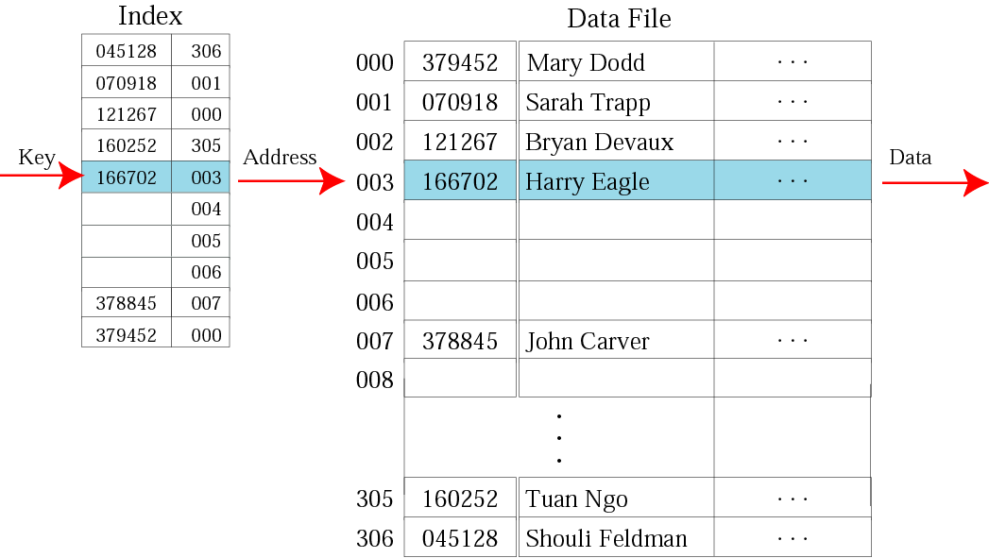
Logical view of an indexed file

Slide 32
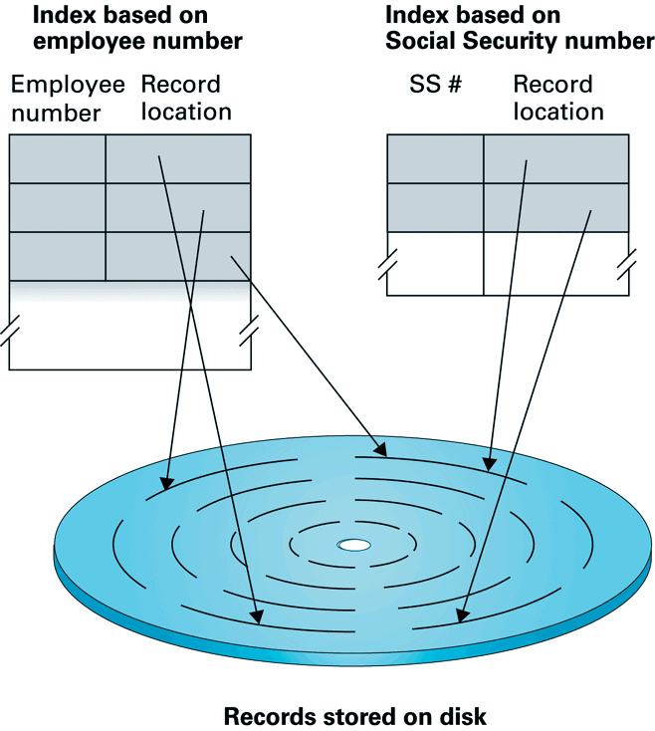
An inverted file

Slide 33
HASHED
FILES

Slide 34
Terminology
Bucket: section of the data storage area.
Key: identifier for a block of information.
Hash function: takes as input a key and outputs a bucket number.
Collision: two keys yield the same bucket number.

Slide 35
Hashing
In hashing the index file is replaced by a hash function.
  The storage space is divided into buckets.
  Each record has a key field. Each record is stored in the bucket corresponding to the hash of its key.
  A hash function computes a bucket number for each key value.
Advantage: no index table needed.
Disadvantages:
i) hash function needs careful design;
ii) unpredictable performance

Slide 36
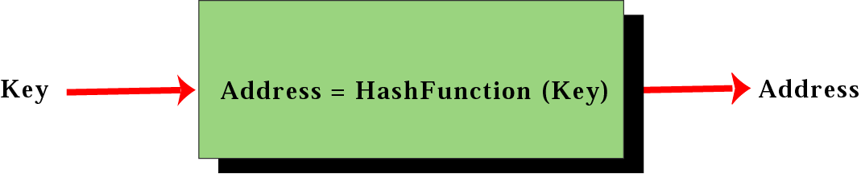
Mapping in a hashed file
A hashed file uses a hash function to map the key to the address.
Eliminates the need for an extra file (index).
There is no need for an index and all of the overhead associated with it.

Slide 37
Hash Functions
Hash Function Requirements
  Easily and quickly computed.
  Values evenly spread over the bucket numbers.
  What can go wrong: bucket number computed from 1st and 3rd characters of a name:
  Brown, Brook, Broom, Broadhead, Biot, Bloom, …
Examples of Hash Functions
  Mid square: compute (key x key) and
  set bucket number = middle digits.
  Extraction: select digits from certain positions within the key.
  Divide key by number of buckets and use the remainder.

Slide 38
Hashing methods
Direct Hashing –
the key is the address without any algorithmic manipulation.
Modulo Division Hashing – (Division remainder hashing)
divides the key by the file size and
use the remainder plus 1 for the address.
Digit Extraction Hashing –
selected digits are extracted from the key and used as the address.

Slide 39
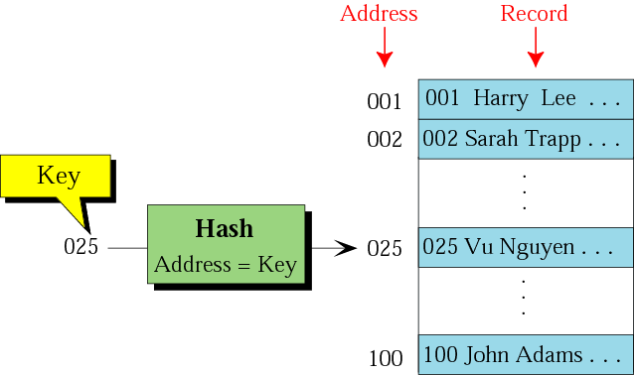
Direct hashing
Direct Hashing –
the key is the address without any algorithmic manipulation.

Slide 40
Direct Hashing
the file must contain a record for every possible key.
Adv. – no collision.
Disadv. – space is wasted.
(Store AU students records based on AU ID)
ID=7 digits, there are about 14,000 students
Hashing techniques –
map a large population of possible keys into
a small address space.

Slide 41
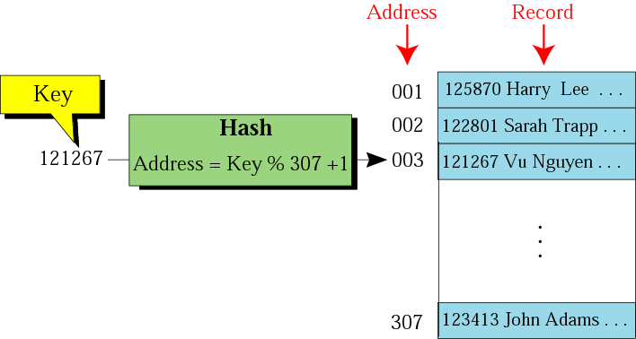
Modulo division
address = key % list_size + 1
list_size : a prime number produces fewer collisions
A new employee numbering system
that will handle 1 million employees.

Slide 42
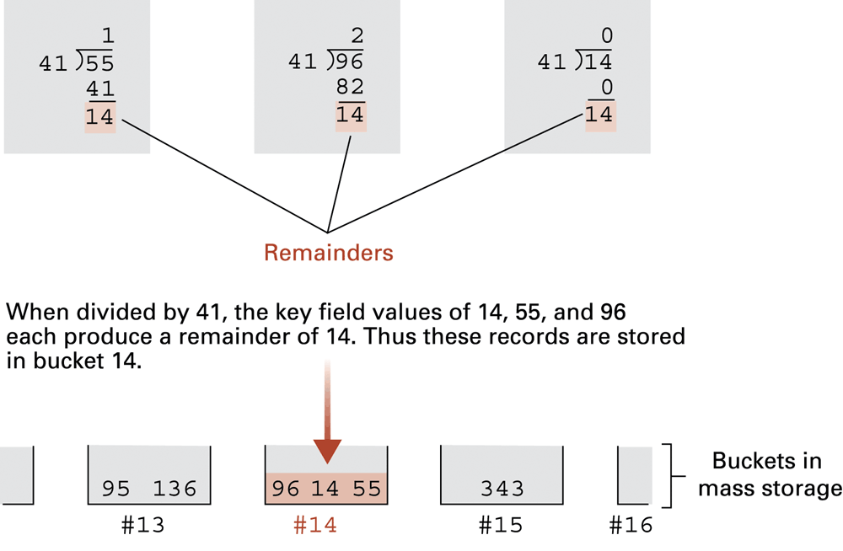
The rudiments of a hashing system, in which each bucket holds those records that hash to that bucket number

Slide 43
Digit Extraction Hashing
selected digits are extracted from the key
and used as the address.
For example : 1,3,4
6-digit employee number → → → 3-digit address
  125870 → 158
  122801 → 128
  121267 → 112
  …
  123413 → 134

Slide 44
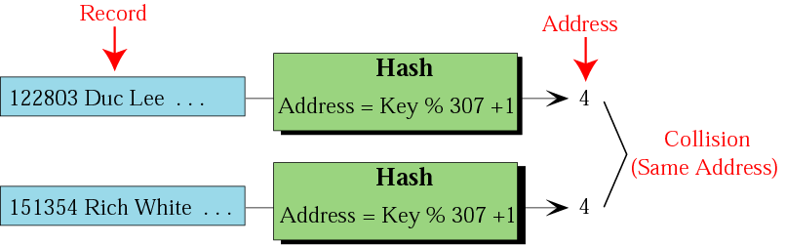
Collision
Because there are many keys for each address in the file, there is a possibility that more than one key will hash to the same address in the file.
Synonyms – the set of keys that hash to the same address.
Collision – a hashing algorithm produces an address for an insertion key, and that address is already occupied.
Prime area – the part of the file that contains all of the home addresses.
Home address

Slide 45
Collisions in Hashing
Collision: The case of two keys hashing to the same bucket
  Clustering problem: Poorly designed hashing function can have uneven distribution of keys into buckets
  Collision also becomes a problem when there aren’t enough buckets (probability greatly increases as load factor (% of buckets filled) approaches 75%)
  Solution: somewhere between 50% and 75% load factor, increase number of buckets and rehash all data

Slide 46
Collision Resolution
With the exception of the directed hashing,
none of the methods we discussed creates one-to-one mapping.
Several collision resolution methods :
  Open addressing resolution
  Linked list resolution
  Bucket hashing resolution

Slide 47
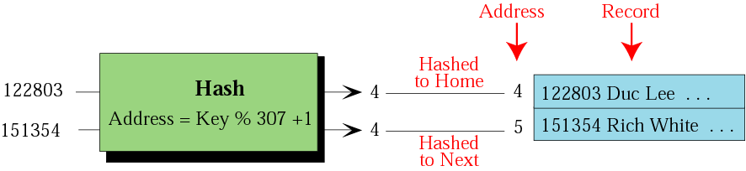
Open addressing resolution
Resolve collisions in the prime area.
The prime area addresses are searched for an open or unoccupied record where the new data can be placed.
One simplest strategy –
the next address (home address + 1)
Disadv. –
each collision resolution increases the possibility of future collisions.

Slide 48
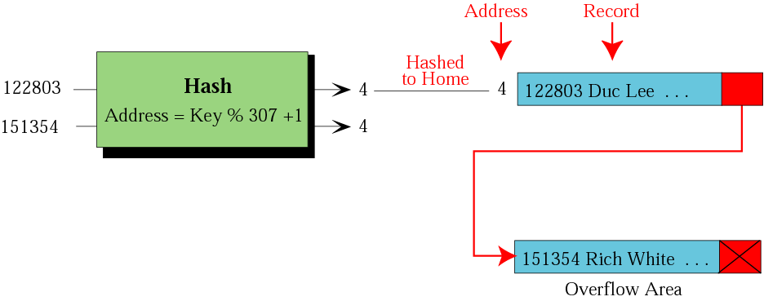
Linked list resolution
The first record is stored in the home address (prime area), but it contains a pointer to the second record. (overflow area)

Slide 49
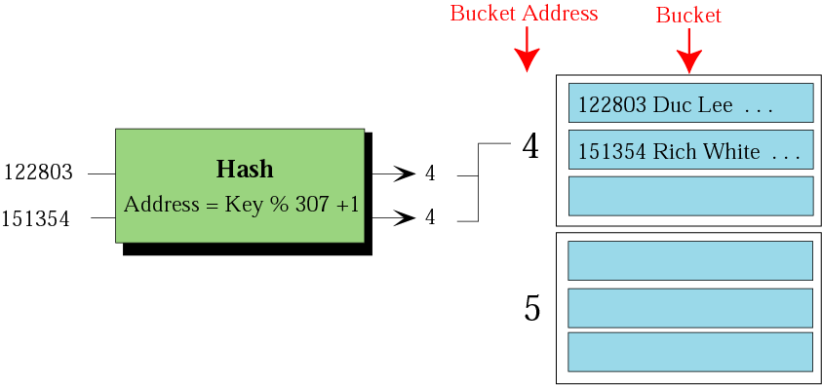
Bucket hashing resolution
Bucket –
a node that can accommodate more than one record.

